Slide 1
Bayesian integrative analysis and prediction with application to atherosclerosis cardiovascular disease (Thierry Chekouo, and Sandra Safo 2023)
Aidan Neher, Biostatistics PhD Student
April 14, 2023
Notes:
Hello everyone! Today I’ll be sharing my research thus far.

Slide 2
What will I share?
Intro: Bayesian Analysis/ Motivation for Method
Model Formulation
Posterior Inference: MCMC
Conclusions/ Possible Extensions
Intro research with Mark Fiecas, Thierry Chekouo, and Sandra Safo

Slide 3
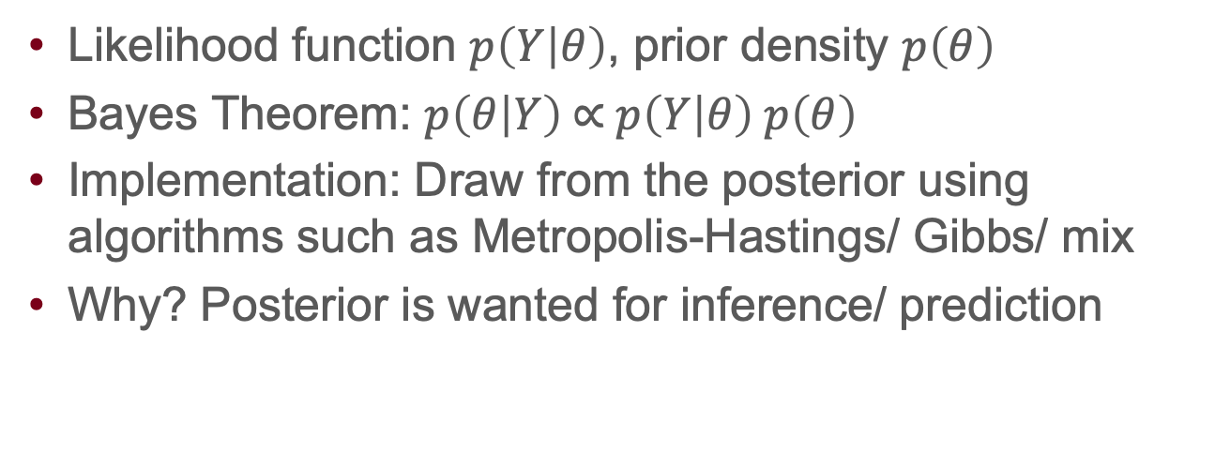
Intro: Bayesian Analysis Ingredients
Likelihood function $p\left(Y | θ\right)$, prior density $p\left(θ\right)$
Bayes Theorem: $p\left(θ | Y\right) \text{∝} p\left(Y | θ\right) p\left(θ\right)$
Implementation: Draw from the posterior using algorithms such as Metropolis-Hastings/ Gibbs/ mix
Why? Posterior is wanted for inference/ prediction

Slide 4
Intro: Explicit modeling of factors shared across data helps interpretability
Frequentist methods exist for joint association and prediction e.g. Luo et al. (2016) and Safo et al. (2021)
This method: Factor analysis + Bayesian framework for joint association and prediction
Why? Factor analysis groups observed features into fewer unobserved features, latent factors AND Bayesian approach allows prior grouping information

Slide 5
Intro: Problem-driven development
Authors want to ID genetic variants, genes and pathways that contribute to 10-year atherosclerosis cardiovascular disease (ASCVD)
Why?
Problem: CVD leading death cause in the US (AHA, 2016)
Environmental risk factors for ASCVD (e.g., age, gender) account for ~half of ASCVD cases (Bartels et al. 2012)
Access to data: Emory University and Georgia Tech Predictive Health Institute study

Slide 6
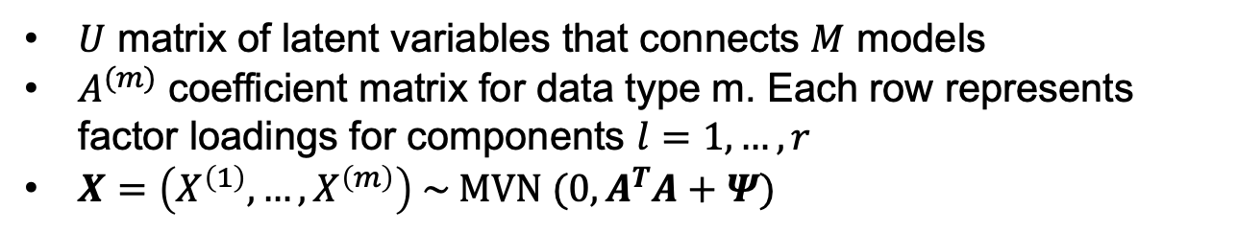
Model: Factor analysis relates data
$U$ matrix of latent variables that connects $M$ models
$A^{(m)}$ coefficient matrix for data type m. Each row represents factor loadings for components $l=1,…,r$
$X=\left(X^{\left(1\right)},…, X^{\left(m\right)}\right) \sim MVN (0, A^{T}A+Ψ)$
Covariates data type $m=M+1$

Slide 7

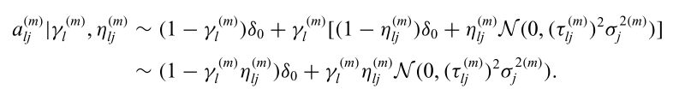
Model: Binary indicators for component/ feature activation
Component indicator prior parameter Beta(a,b)
Indicates variable j active/ not for component l
Indicates component l active/ not for data m

Slide 8


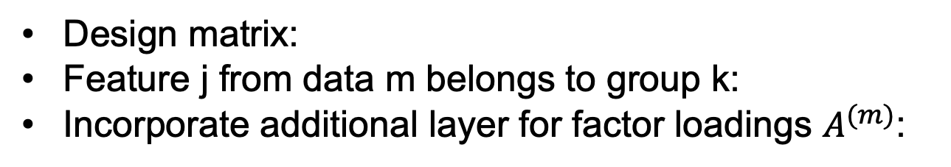
Model: Incorporating group information
Design matrix:
Feature j from data m belongs to group k:
Incorporate additional layer for factor loadings $A^{(m)}$:

Slide 9


Model: Incorporating group information
To determine groups that contribute to active components, let latent variable
If group k contributes to active component l:
Beta(a,b)?

Slide 10
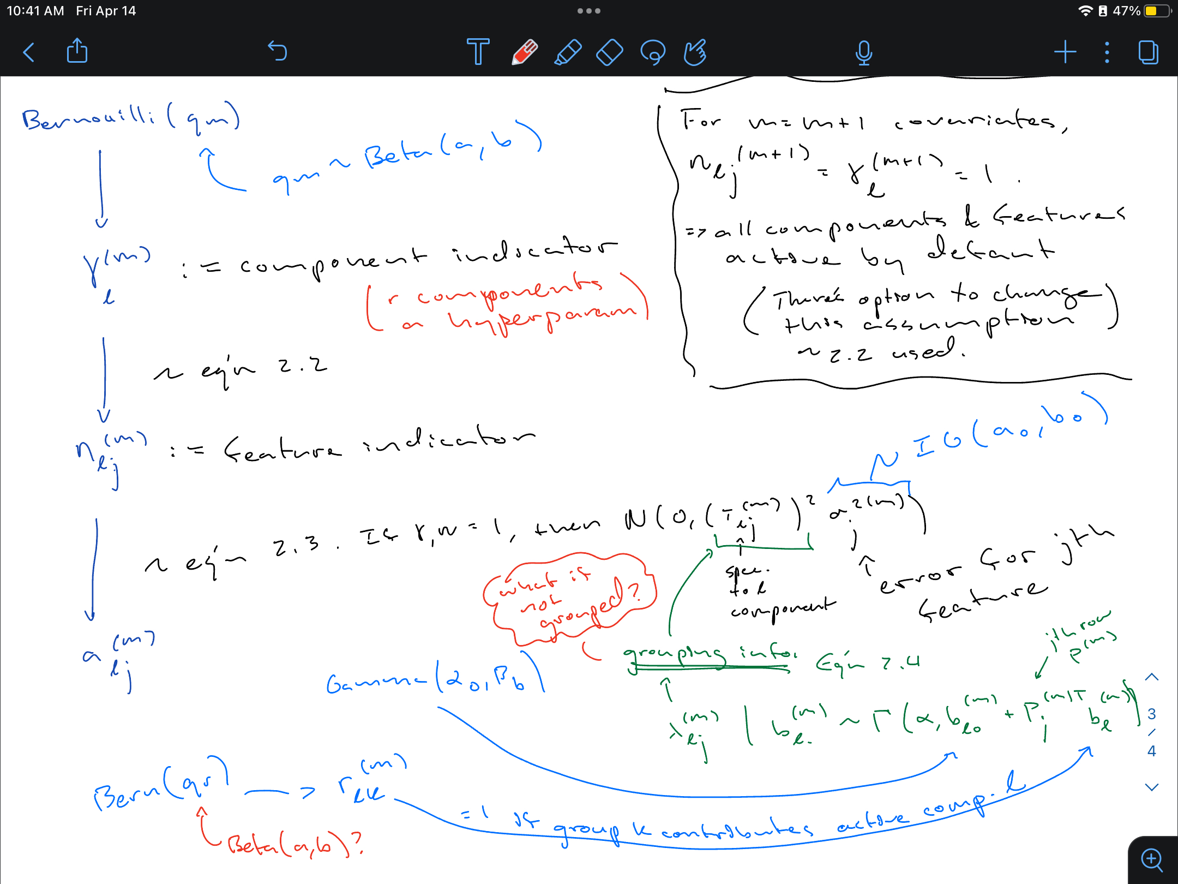

Slide 11
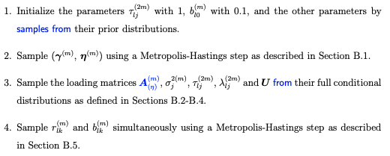

Posterior Inference: MCMC mixture
Aim: Estimate component, feature indictors & $A^{(m)}$

Slide 12
Conclusions/ Possible Extensions
Bayesian hierarchical model that integrates multiple data, an outcome, clinical covariates, and grouping information does variable selection well
Data analysis identified important genes/ SNPs and their corresponding groups, which eases interpretation
Extensions: Other outcome types e.g. survival time, missing data e.g. Bayesian imputation, extend to other omics types e.g. binary, categorical/ count

Slide 13

Intro: Multiview learning of interest
Cooperative learning for Multiview analysis (Ding et al. 2022), data fusion, data integration, multi-omics, …
Technological experimentation e.g. Plink for GWAS
NSF Graduate Research Fellowship Program application: a good learning experience
Notes:
My research interests have evolved over the years but have a consistent theme: a desire to understand complex systems and distill learnings.
Last semester, I had the opportunity to explore with Mark Fiecas as my mentor thanks to the Stat Gen Training Program. On reading Robert Tibshirani’s research group’s paper Cooperative learning for Multiview analysis, I was attracted to Multiview learning methods, methods that learn shared patterns across multiple distinct feature sets/ data sources¹. Then I asked for reading suggestions from Sandra Safo and discovered “Multiview learning” is also known as data fusion, data integration, or can be associated with multi-omics analyses. Also last semester, I became familiar with -omics technologies, using PLINK to perform a GWAS, and applied to the NSF’s Graduate Research Fellowship Program, which I learned I did not get. But that’s okay because I’m appreciative of the learning experience applying to an NSF fellowship and considering how my research might unfold in the next three years.

Slide 14
Why? Extension to a longitudinal context
Adolescent Brain and Cognitive Development (ABCD) Study is the largest longitudinal study of brain development and child health in the US
Bayesian integrative analysis and prediction with application to atherosclerosis cardiovascular disease (Chekouo and Safo 2021) as inspiration
Notes:
In my first year, through an RA, I became familiar with the Adolescent Brain and Cognitive Development (ABCD) Study. The ABCD Study is an ongoing longitudinal research study involving data collection at 21 sites across the United States. It is the largest long-term study of brain development and child health in the US³. The study explores the environmental, social, genetic, and biological factors that affect brain and cognitive development, behavior, and health⁴. There are many data types available, so Mark and I wondered how we might apply Multiview learning in this longitudinal context.
Mark expressed the thought of developing a longitudinal data analysis method to Thierry Chekouo and turned-out Thierry had already been considering such a project. Thierry and Sandra Safo had extended data integration methods for variable selection and prediction to a Bayesian framework in their recently published Bayesian integrative analysis and prediction with application to atherosclerosis cardiovascular disease, which included an R package BIPnet. Thierry, Sandra, Mark, and I first met to discuss extending this method to be capable of longitudinal analysis with application to the ABCD Study early this semester.

Slide 15
Adolescent Brain and Cognitive Development (ABCD) Study®
COVID-19 disrupted the ABCD Study’s data collection
Excluding subjects missing neuroimaging data: 7,827 subjects available/ 11,880 invited from ages 9-10
34 regions x2 hemispheres x2 sMRI metrics (Cortical Thickness and Surface Area) = 128 omics features
Notes:
Since wanting to extend BIPnet longitudinally, we have started analysis pipeline development, exploratory data analyses, and model formulation. Also, I have spent time getting familiar with C++ and the Rcpp package.
For better or for worse, the COVID-19 disrupted the ABCD Study’s data collection. Neuroimaging data is collected every two years, and the pandemic started between baseline and time point 2 (T2). In our exploratory analyses, we observed substantial neuroimaging missingness at T2. Consequently, we restricted our sample to subjects with neuroimaging data at both time points. Doing so leaves us with 7,827 subjects/ 11,880 subjects invited. There is missingness in the covariates/ response variables we are including but plan to impute this data. Note, when I say neuroimaging data, for now, I mean the two structural MRI metrics Surface Area and Cortical Thickness for 34 regions x2 hemispheres x2 metrics = 128 features.

Slide 16
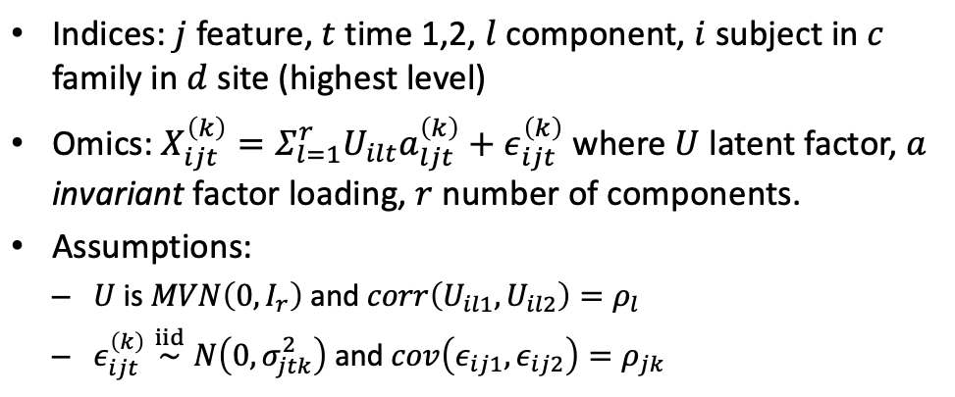
Model Formulation: Early thoughts
Notes:
In a Bayesian analysis, we ultimately want the joint posterior distribution, so we can perform variable selection/prediction. While I still need to work through the notation and think through the details, here I am presenting the model at a high level. This represents …

Slide 17
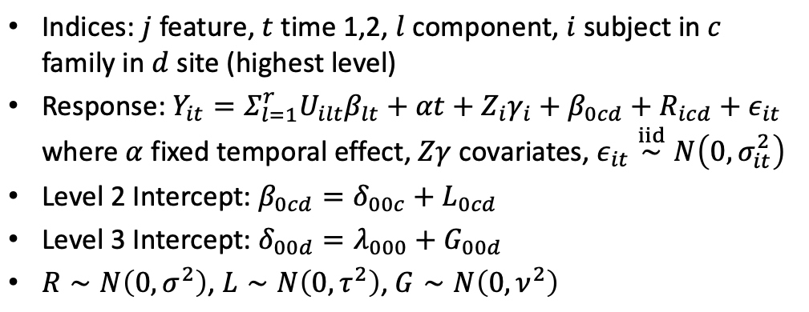
Model Formulation: Early thoughts
Notes:
One complication of the ABCD Study is that data is collected across 21 sites and subjects might share the same family. The variables … represent random intercepts to account for nested effects, but we need to interpret/resolve error terms in relation to these random effects in the outcome equation.

Slide 18
Next Step/ Ponderings
Next Step: Implement cross-sectionally strictly in R
Ponderings:
Is the combination of imaging data, covariates, and clinical outcomes biologically meaningful? How might we incorporate prior information?
Are 2 time points sufficient for considering the proposed method’s efficacy longitudinally
How might I implement the method so it’s scalable?
Deadlines helpful: ENAR paper competition ☺
Notes:
Presently, I have a few questions and next steps I’m pondering.
Firstly, is the combination of imaging data, covariates, and clinical outcomes biologically meaningful? How might we incorporate prior information? At Saonli and Mark’s talk at the Human in the Data Spotlight Series last Thursday, I was reminded of the importance of including a subject matter expert in the conversation, so I’m wondering how, as a student, I might build relationships with non-statistics collaborators.
Secondly, are two time points sufficient for considering the proposed method’s efficacy longitudinally? I’m unsure at present. I have more to read on longitudinal analysis. Perhaps we can include additional data as it’s released or might consider adding/ switching to other data.
Thirdly, how might I implement the method so it’s scalable? Sandra mentioned her general preference for frequentist methods thanks to their relative computational efficiency, but Bayesian methods offer the chance to incorporate prior information. I’m wondering how to architect the software so adding additional omics data doesn’t increase the runtime beyond practicality.
Regardless, I’m planning to submit this work to this fall’s ENAR student paper competition.

Slide 19
Thank you
Mark, Sandra, and Thierry for their mentorship
NIH for making this work possible
Stat Gen training program and its organizers Saonli, Tianzhong, and Wei Pan
Biostats faculty generally, fellow students, family, and friends for their support
Notes:
Finally, I’d like to acknowledge Mark, Sandra, and Thierry for their mentorship, and the NIH for making this work possible. Also, thanks to this Stat Gen training program, its organizers Saonli, Tianzhong, and Wei Pan, the biostats faculty generally, fellow students, family, and friends for their support.

Slide 20


